Slide 1
C++ with Cevelop
Better Way to Write Class

Slide 2
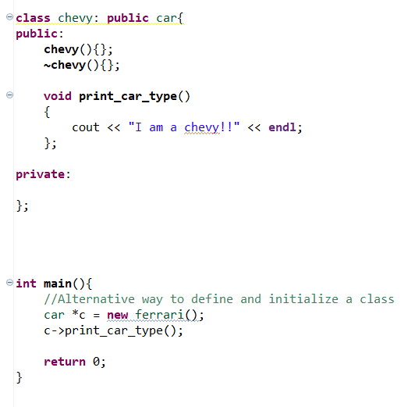
What We Learned On How to Write Class
We write class on the same file as our Main function
This is cumbersome, disorganized, and Hard to Follow

Slide 3
Better Way to Write Classes
The Syntax is the Same
The Class is at the header file and constructor/destructor/function definition is at the source files
Caution: .cpp files must declare the header that contains the class
Header Files (ex. car.h) | Source File (ex. car.cpp)
class car { public: car(); ~car(); private: } | #include “car.h” car::car { } car::~car{ }

